Slide 1
Algorithmic Curation & Dissemination
JOUR479V/779V – Computational Journalism
University of Maryland, College Park
Nick Diakopoulos, Ph.D.

Slide 2
News Consumption 101
How do you find news that is interesting / relevant to you?
Tools / Platforms / Apps?
Strategies?

Slide 3
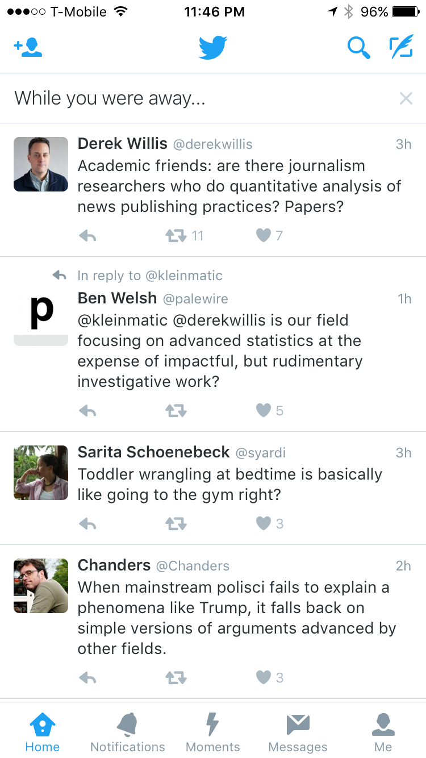
Feed Curation
“You may see a summary of the most interesting Tweets you received since your last visit, labeled as While you were away.”
“Tweets you are likely to care about most will show up first in your timeline. We choose them based on accounts you interact with most, Tweets you engage with, and much more.”
https://support.twitter.com/articles/164083
Notes:
Feed curation is a sort of special case of news recommendation, where it’s a recommendation for what to pay attention to from a set of things that you’ve already curated and which are presented in some chronological flow.
What are the pro / cons to seeing a curated list versus seeing everything? Curated content versus having already curated the people I want to pay attention to b/c I’ve vetted the person and I know that person can provide a bit of serendipity within their range.

Slide 4

44% of US Adults get news on Facebook; 62% from social media
Facebook & Google account for 80% of traffic to sites in the Parse.ly media network
Do you see everything that your friends post to FB?
Notes:
The other aspect of news that’s being heavily impacted by computing now is in the distribution and dissemination of content, through search, newsfeeds, and recommendations.
It won’t be a surprise to anyone here that Facebook dominates news distribution. Especially for publishers that rely on an advertising model and who need a large traffic volume, they are hooked to FB as a distribution mechanism.
Do you see everything that your friends post on FB?

Slide 5
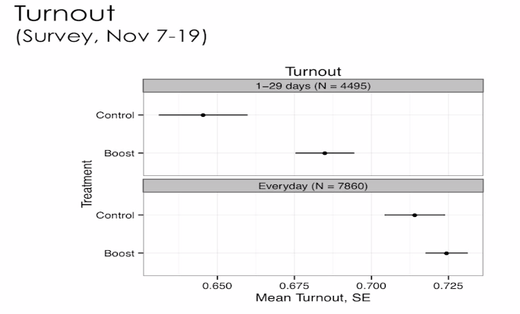
Facebook, News, and Turnout
Credit: Solomon Messing, Facebook
Notes:
But while Fake news is an issue, what’s perhaps more worrisome is Facebook’s awesome power to increase voter turnout.
1.9M people in study Aug – Nov 2012. 12.3k responses to post-election survey
Tweak news feed – if any of your friends had shared a news story would boost so it was up top and more likely to see. Then survey 12k and ask how much they follow govt – ppl more interested in politics after being more exposed to more news. It was also shown to boost self-reported turnout voting “more likely to say they had voted” – had a stronger effect on people who were more ocassional in loggin in b/c ppl logging in everyday were already on the upper end of exposure.

Slide 6
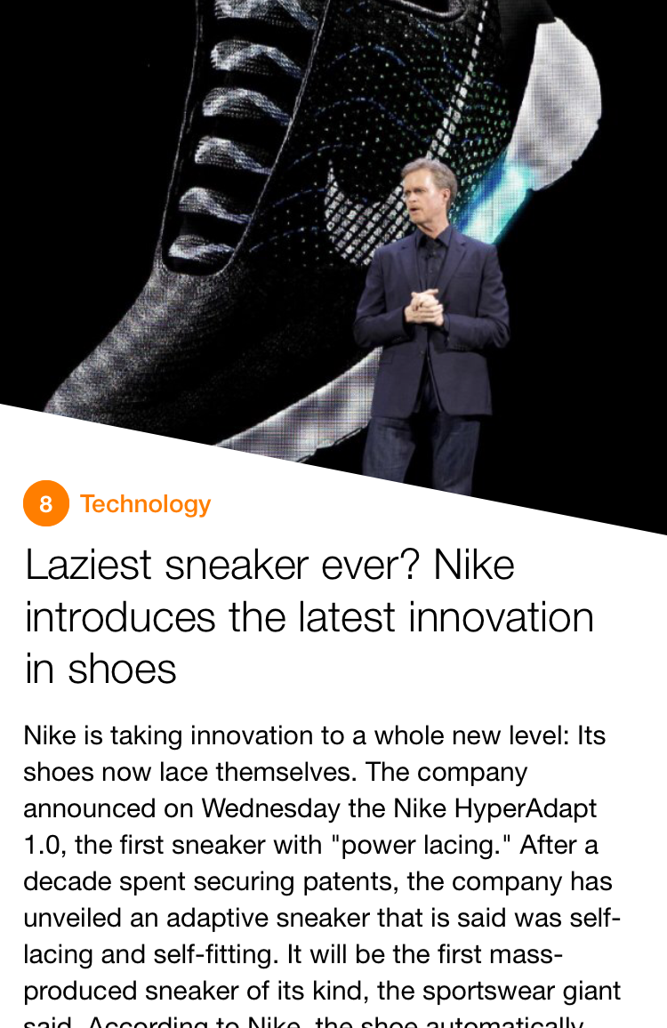
From Curation to Summarization
https://mobile.yahoo.com/newsdigest/
Notes:
Yahoo news digest
My understanding is that while the articles themselves are summarized, the choice of exactly *which* articles to include in the twice daily briefing is also moderated by a human editor who is using analytics to make decisions.

Slide 7
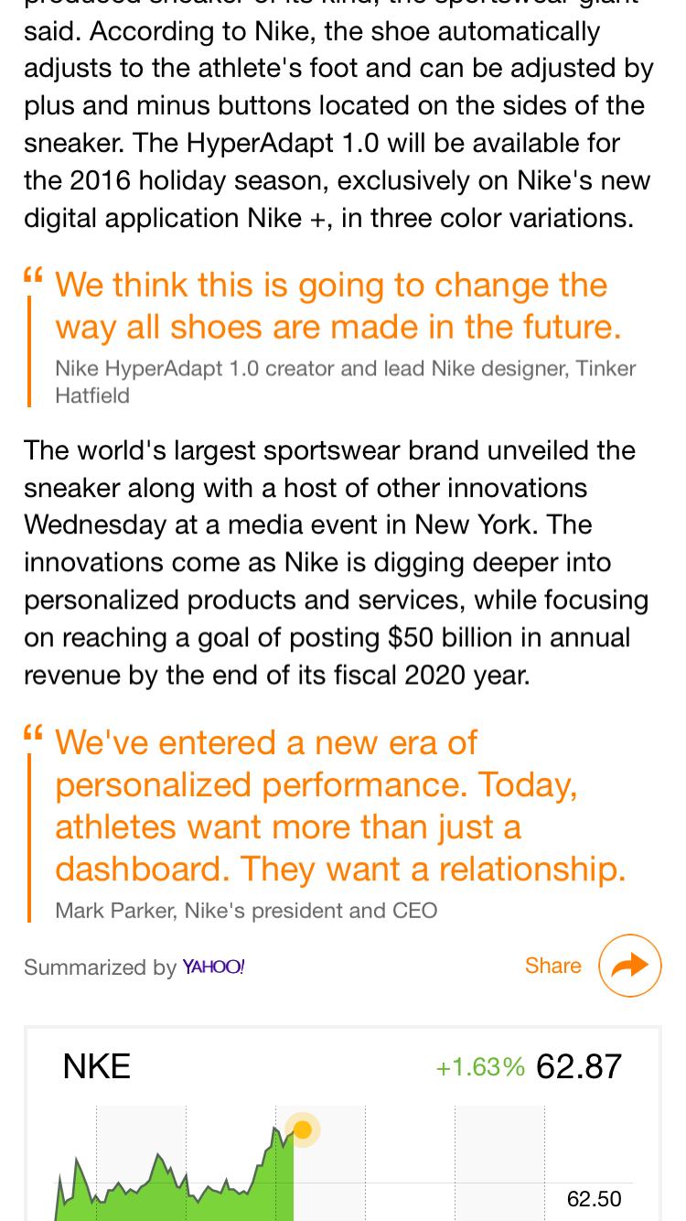
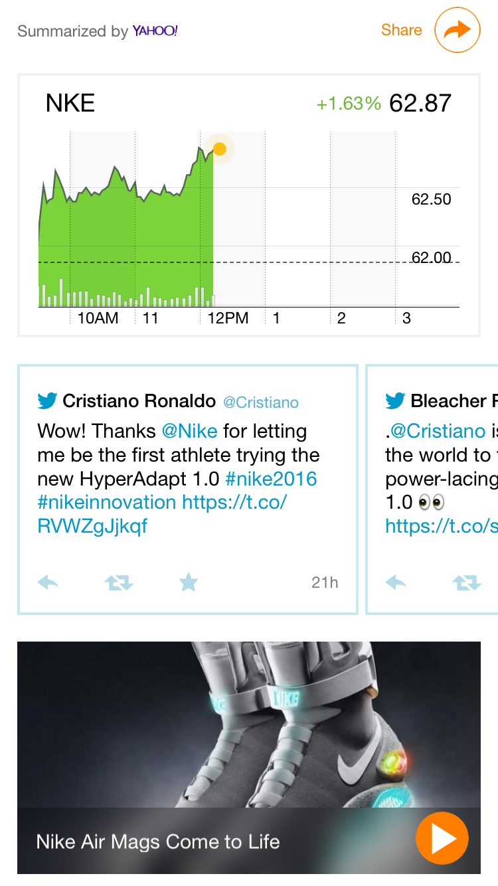
Notes:
They’re also adding a lot of context … like stock charts, tweets / reactions, videos, maps,

Slide 8
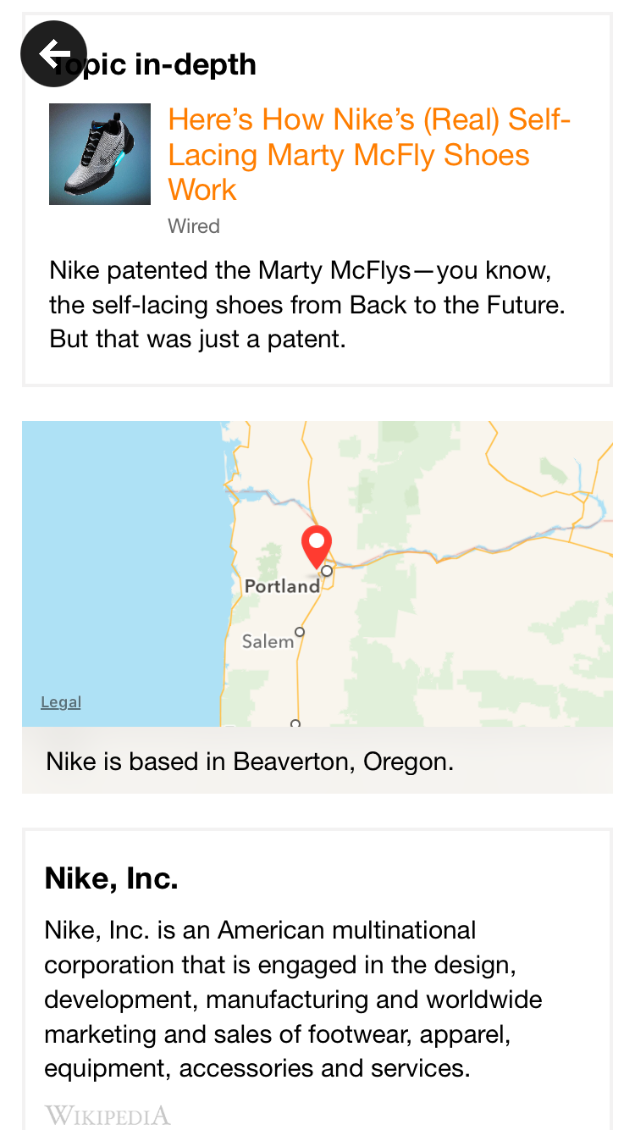
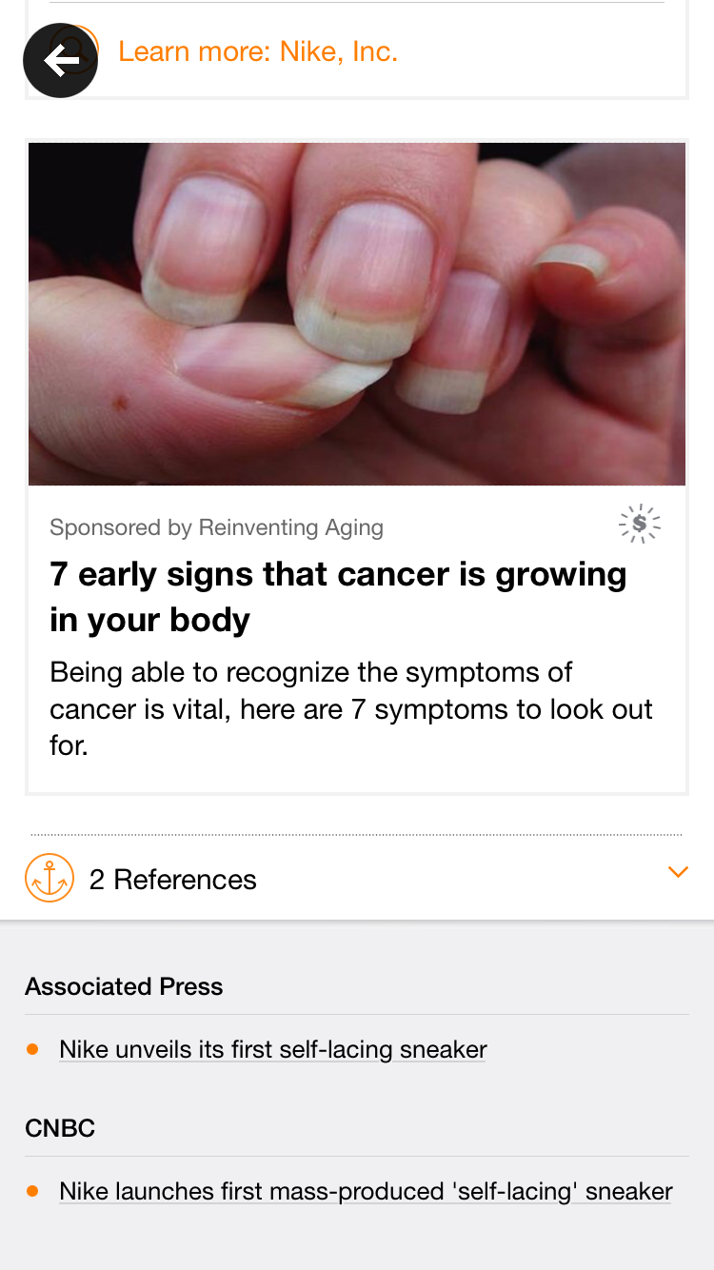
Notes:
And at the very bottom below the ads are the original references from which the story was summarized.

Slide 9
Personalization Two Ways
Recommendation
Match your interests, background, consumption patterns with other content that you might like e.g. homepages, apps, newsletters, portals
Content Adaptation
Change the content itself to make it more appealing, connect better with your interests, or with geography of outlet
Notes:
Content adaptation happening via automation … talk about AP and others’ aspirations to deliver different versions of sports stories to clients in diff geographies.

Slide 10
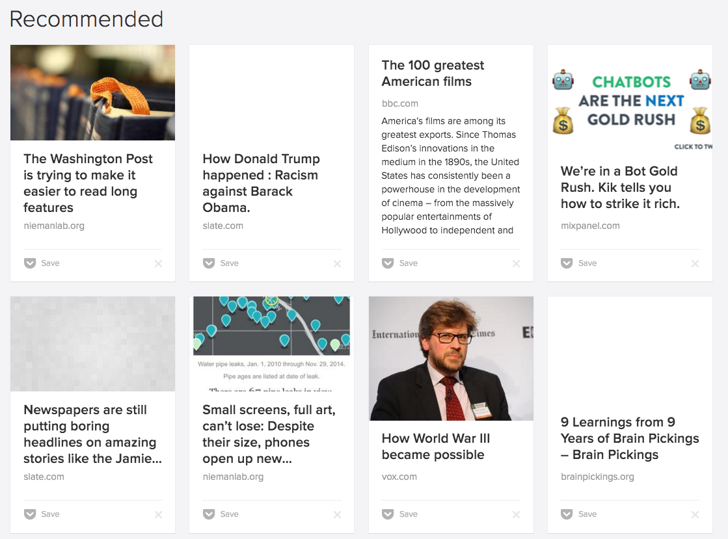
News Recommendation
Notes:
News recommendation helps deal with the issue of scale and finding the things that should be interesting to you but you don’t even know about.
In the case of pocket it’s based on the articles that I’ve saved in that app.

Slide 11
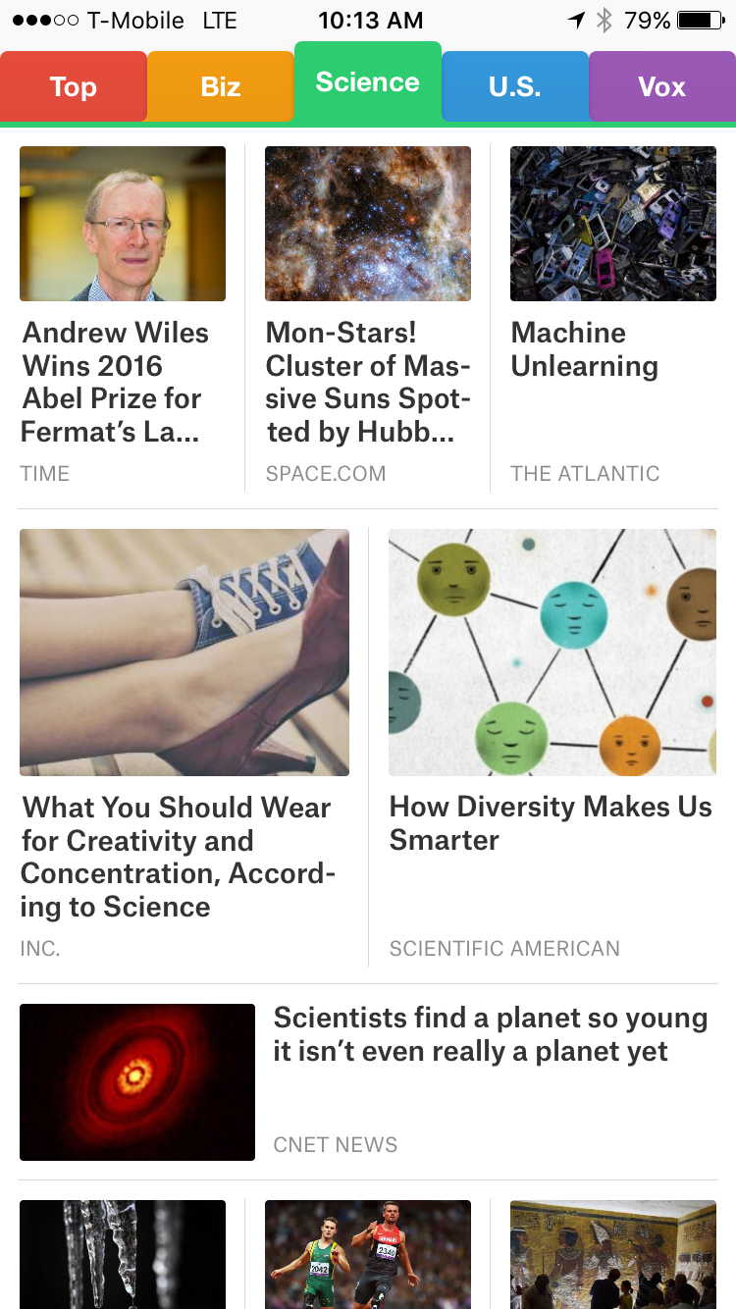
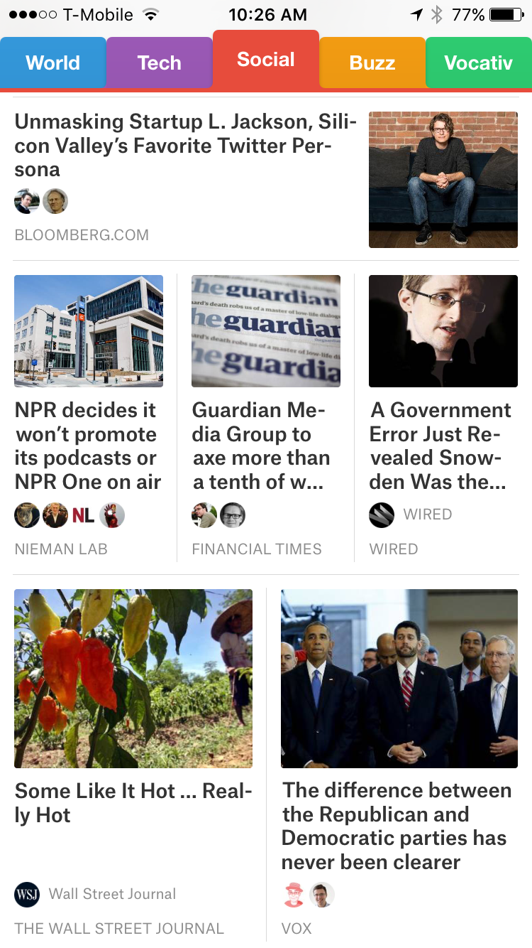
News Recommendation
Notes:
Smart News App says that it “curated the must-read stories that matter now”. It also has a social tab where it mines the stories that your contacts are sharing.

Slide 12
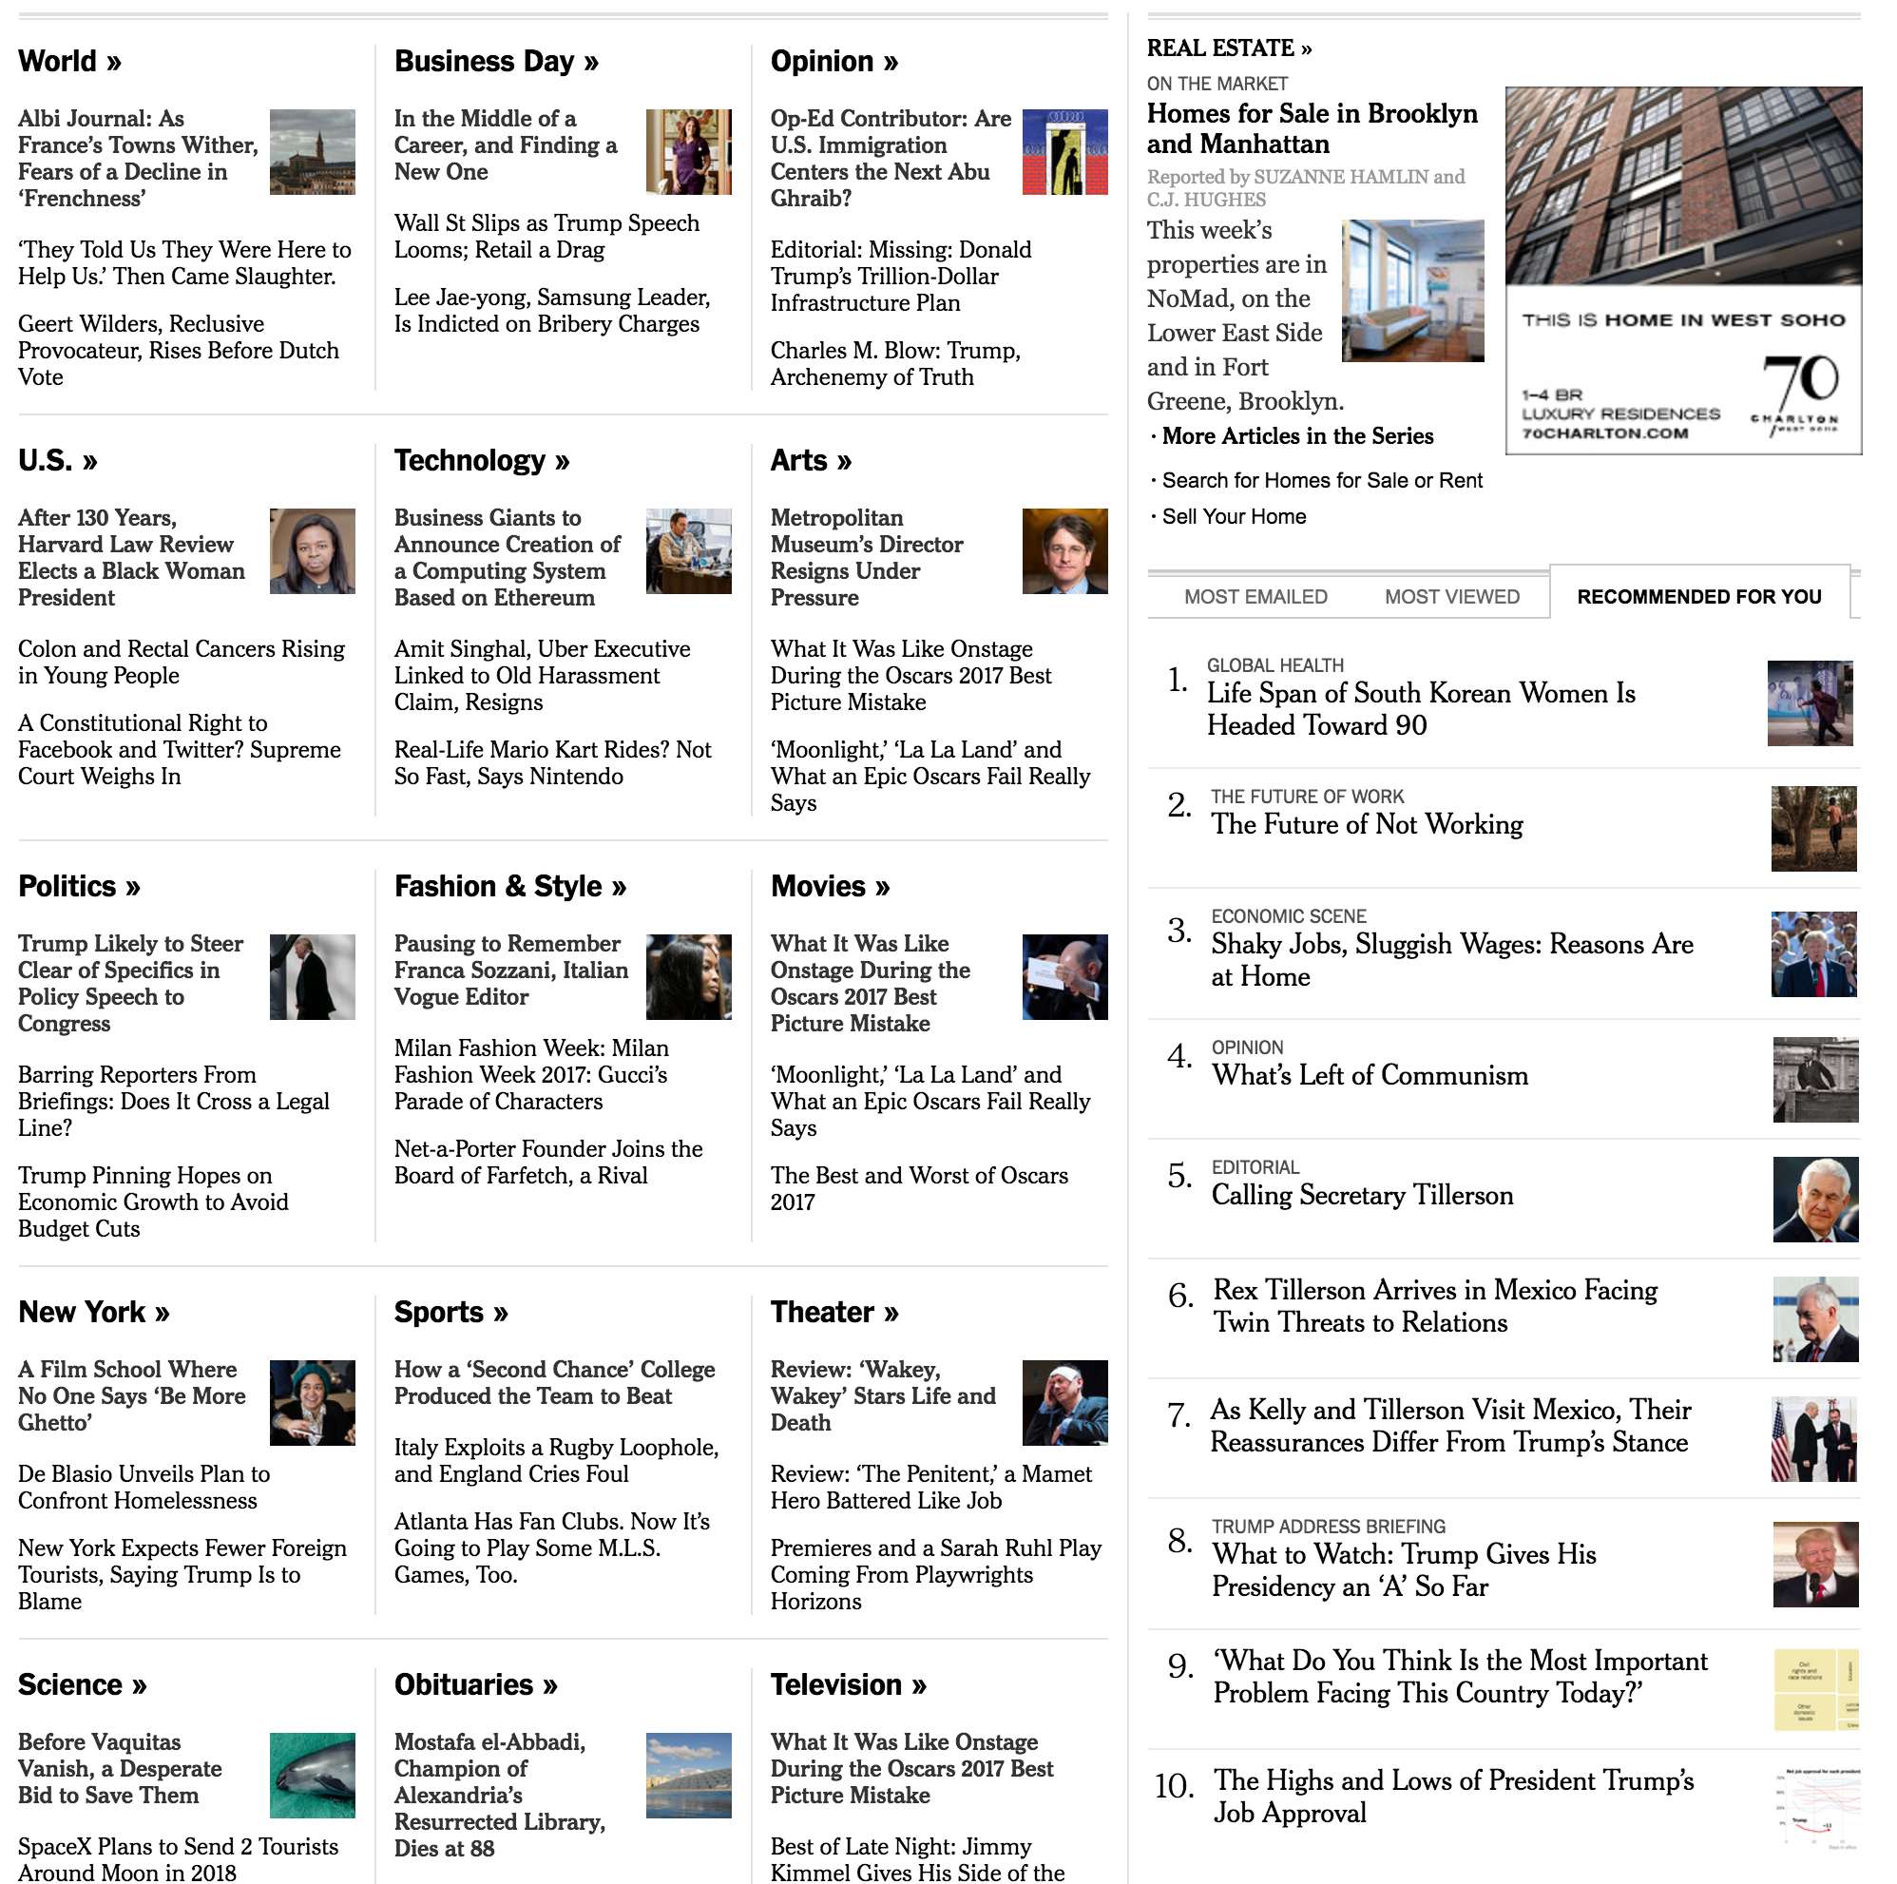
Notes:
News recommendation also happens on homepages like NYT and WaPo

Slide 13
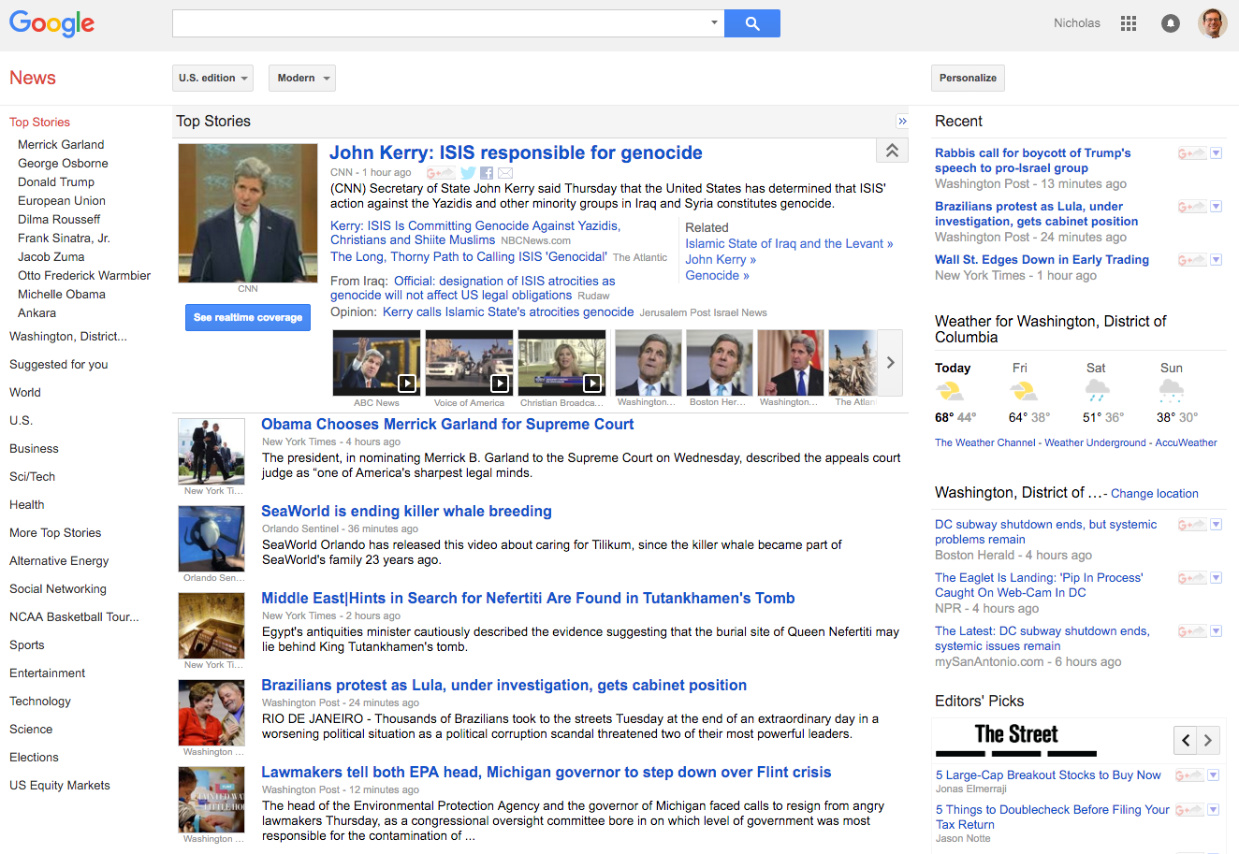
Portal Personalization
news.google.com
Notes:
Walk through the various personalization options on Google.
Personalization vs. adaptation
News cluster summarization is also in use on google. What sites get selected as representative?
Why does this even matter? Filter bubble is one concern.

Slide 14
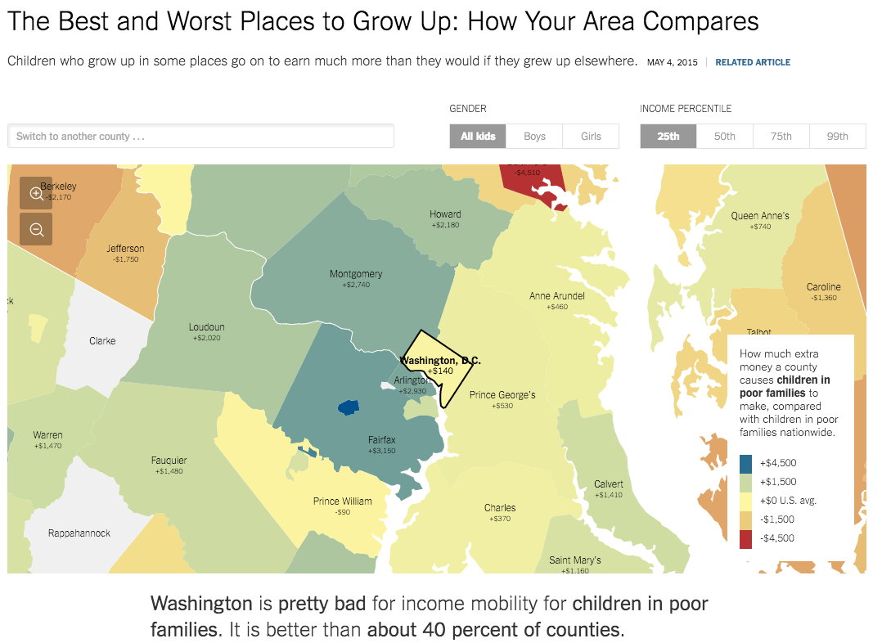
Content Personalization
http://www.nytimes.com/interactive/2015/05/03/upshot/the-best-and-worst-places-to-grow-up-how-your-area-compares.html
Notes:
How do we still have conversations about the same thing if everyone sees a different version?
Are there privacy issues related to this?

Slide 15
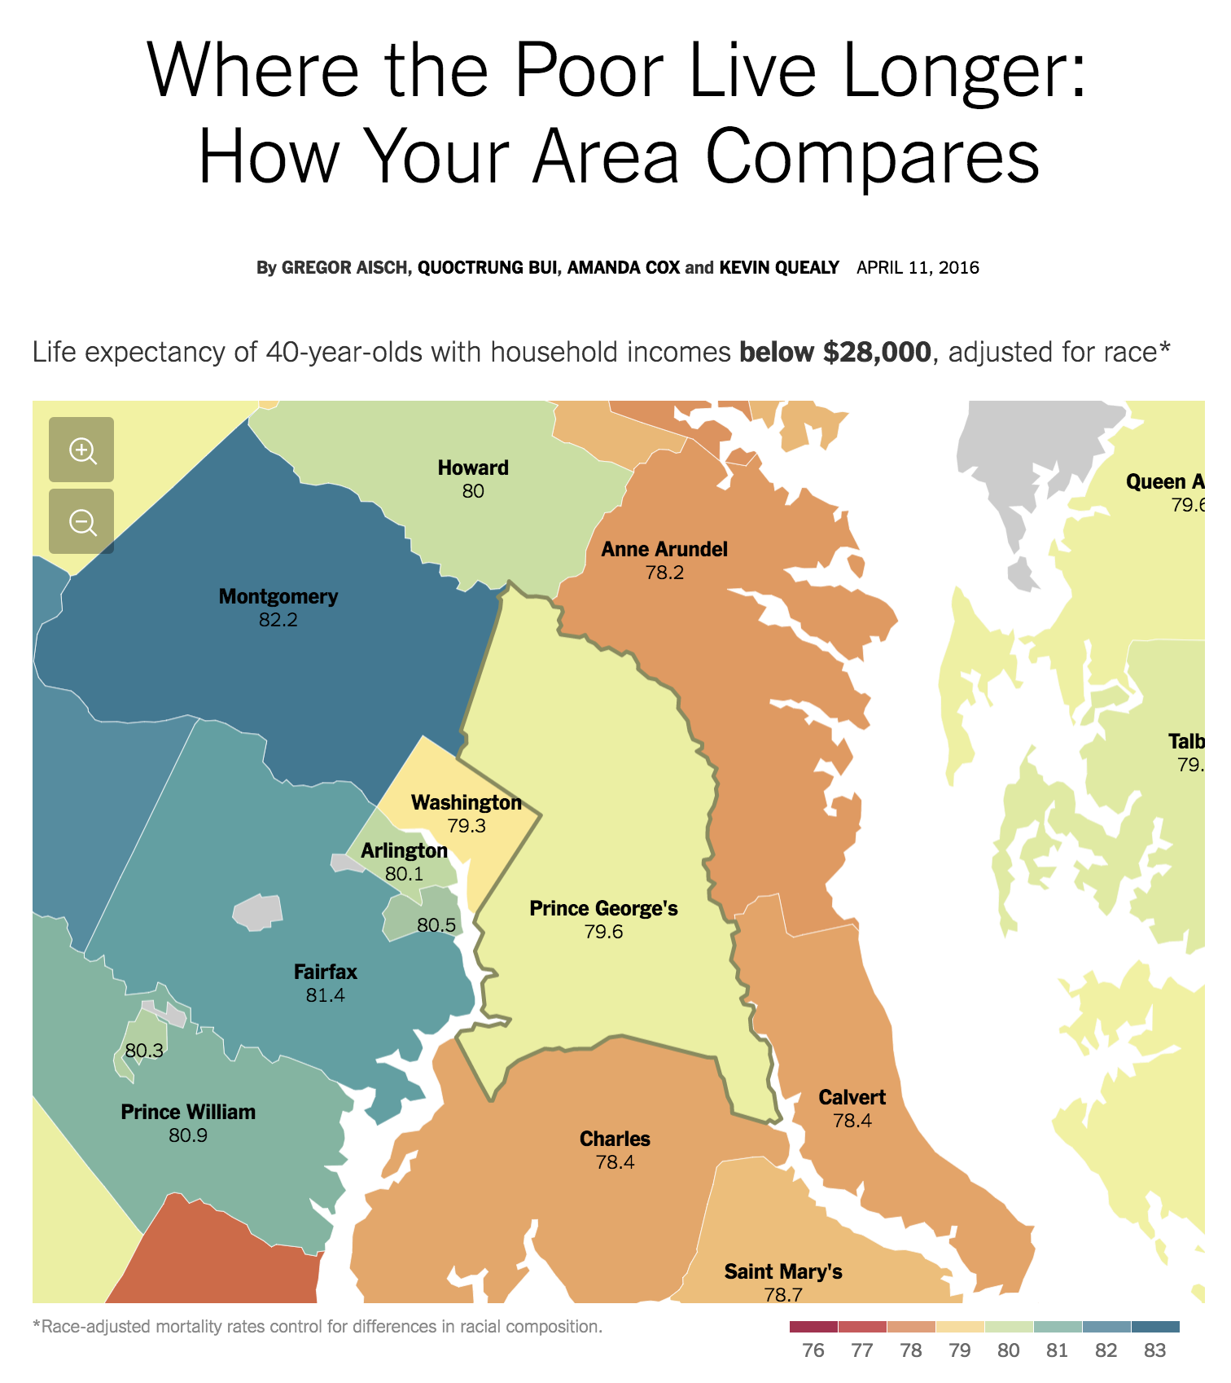
https://www.nytimes.com/interactive/2016/04/11/upshot/where-the-poor-live-longer-how-your-area-compares.html
Notes:
To recap, we can have personalization in terms of the articles you’re offered (recommendation) or the individual pieces of content you consume (content personalization).

Slide 16
Readings
Bias in algorithmic filtering and personalization
Can algorithms really replace human news filters (i.e. gatekeepers)? What’s the big deal if they do?
Compare and contrast explicit and implicit personalization.
How does algorithmic curation and personalization affect issues such as user autonomy, serendipity, and privacy?
Notes:
Does personalization infringe on autonomy in terms of user choice? What aspects of the algorithm should be controllable to ensure autonomy?
Privacy could be infringed with implicit personalization, or with sharing of personal targeting information b/t platforms

Slide 17
Readings
Facebook Wants you to Vote …
What are the democratic implications of Facebook, and now Twitter, Instagram and others curating what we see?
Facebook is Eating the World
Do you think FB is a media company? Why or why not?
How is algorithmic media curation different or the same from traditional media?
Notes:
Bias: over or underemphasis, the formation of publics or groups of common interest, differential nudging for voter turnout (supression?)
FB publisher? They don’t publish content, but they do affect content consumption a lot; new gatekeeper; make editorial decisions like what content is banned
Difference: scale, opacity (what do they privilege?), non-uniformity

Slide 18
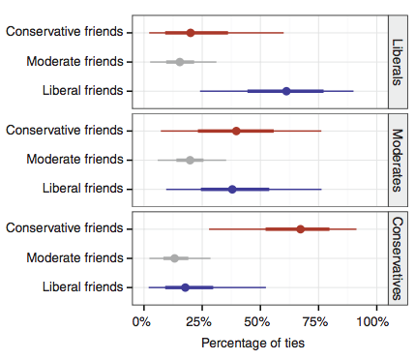
Readings
Exposure to ideologically diverse news and opinion on Facebook
What does this paper say about “Filter Bubbles” and “Echo Chambers”?
Notes:
Filter bubble: “limit exposure to attitude-challenging information”. The media users consume depends on (1) what friends share, (2) how algorithm sorts those articles, (3) what people choose to read.
The paper finds “after ranking , there is on average slightly less cross-cutting content”

Slide 19
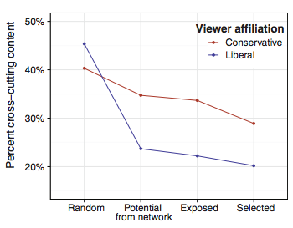
Readings
Exposure to ideologically diverse news and opinion on Facebook
What are some of the limitations?
The paper reports: “Within the population under study here, individual choices … more than algorithms … limit exposure to attitude-challenging content in the context of Facebook”
Do you trust the results?
Notes:
Limit: based only on uses that volunteer their ideology; accuracy of their content classifications; users of FB aren’t fully representative of broader population; exposure to content without clicking it

Slide 20
Readings
Building the NYT Recommendation Engine
What’s the difference between content-based recommendation and collaborative filtering?
What are some of the pitfalls of recommendation systems that the engineers at NYT are trying to avoid?
Notes:
Content-based recs are based on tags (i.e. the content itself). Whereas collaborative filtering is based on finding similar people to you (e.g. read same types of articles).
Pitfalls: what if a reader misses something they would be really in to? Avoid Filter bubble? Inability to recommend newly-published unexplored articles.

Slide 21


Slide 22
Personalized News Design
Groups of three
Find a data story from e.g. 538, Upshot
At least a few hundred words long, maybe even with vis and interactivity
Now think about how to personalize the story based on user profile
For profile consider: Age, gender, education level, location, marital status, political affiliation, ??? e.g.: 65 year-old, woman, with a graduate degree living in Naples, Florida who is divorced and registered democrat
What can you add, change, subtract to your chosen data story to make it more interesting / appealing to chosen user profile?
Be concrete about how the writing and information presentation would change. Create a mockup of the adapted story highlighting how you’ve changed it to appeal to the target user profile.
Can you imagine a set of rules (an algorithm) that would allow a computer to do this personalization? Would it apply to other similar articles?
Present mockup back to class.

